Slide 1
Math Tips
Day 4

Slide 2
Percent Word Problems
Ratio and proportion method

Slide 3
Here are several aids that will help you solve word problems:
Make sure you understand the question that is asked
Sort out the information to make a basic percent problem, such as “30% of what is 17?”
Sometimes, you will have to subtract or add some of the numbers.
The base will always be the original number, price, or total.

Slide 4
The QCG has increased its personnel from 150 COS to 240 from last year. How big is the increase in percent?
Method 1
We begin by subtracting the smaller number (the old value) from the greater number (the new value) to find the amount of change.
240 – 150 = 90

Slide 5
Then we find out how many percent this change corresponds to when compared to the original number of COS
a = r ⋅ b
90= r ⋅150
90/150= r
0.6 = r = 60%

Slide 6
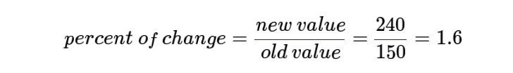
Method 2
We begin by finding the ratio between the old value (the original value) and the new value

Slide 7
As you might remember 100% = 1. Since we have a percent of change that is bigger than 1 we know that we have an increase. To find out how big of an increase we've got we subtract 1 from 1.6.
1.6 – 1 = 0.6
0.6 = 60%

Slide 8
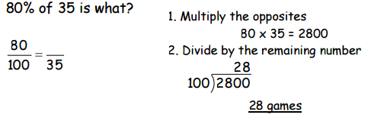
Example:
A baseball pitcher won 80% of the games he pitched. If he pitched 35 ballgames, how many games did he win?

Slide 9
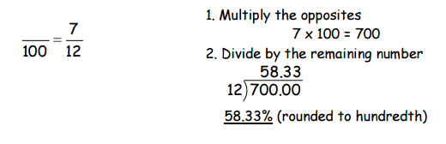
2. Jerry, an electrician, worked 7 months out of the year. What percent of the year did he work? (round answer to the nearest hundredth) What percent of 12 is 7? 12 months = 1 year

Slide 10
Sometimes the information needed to solve a percent word problem is not stated directly. You will need to sort out the numbers given in the problem. Organizing all the information into a box format will help you see what numbers you have and what you need.

Slide 11
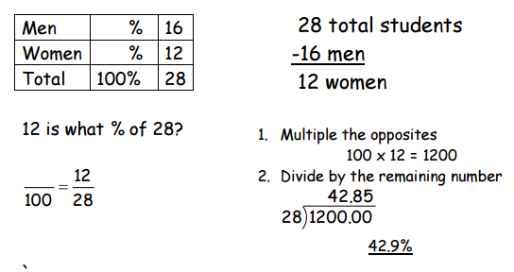
Examples
1. There are 28 students in a class. Sixteen of those students are men. What percent of the class are women? (Round to the nearest tenth)

Slide 12
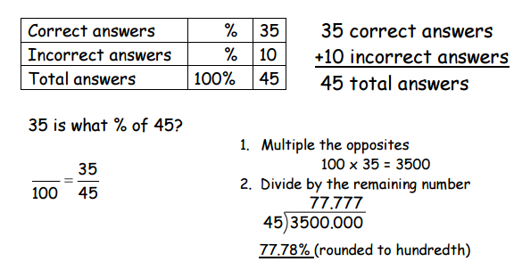
2. Donovan took a math test and got 35 correct and 10 incorrect answers. What was the percentage of correct answers? (Round to the nearest hundredth)

Slide 13
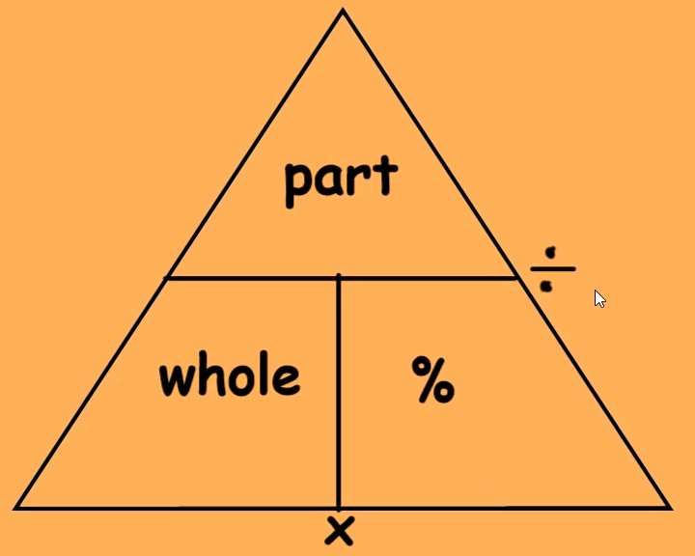
Percentage Triangle

Slide 14
Don’t forget to change your percent to decimal

Slide 15
Percent Word Problems
Directions: Set up a basic percent problem. Sometimes you will have to do extra steps to solve the problem. Follow rounding directions. Answers and solutions start on page 6.

Slide 16
1. A student earned a grade of 80% on a math test that had 20 problems. How many problems on this test did the student answer correctly? (round to the nearest whole number)

Slide 17
2. There are 36 carpenters in a crew. On a certain day, 29 were present. What percent showed up for work? (round to the nearest tenth)

Slide 18
3. A metal bar weighs 8.15 ounces. 93% of the bar is silver. How many ounces of silver are in the bar? (round to the nearest thousandth)

Slide 19
4. A woman put $580 into a savings account for one year. The rate of interest on the account was 6½%. How much was the interest for the year in dollars and cents? (Round to the nearest cent)

Slide 20
5. A student answered 86 problems on a test correctly and received a grade 98%. How many problems were on the test, if all the problems were worth the same number of points? (Round to the nearest whole number)

Slide 21
6. Manuel found a wrecked Trans-Am that he could fix. He bought the car for 65% of the original price of $7200. What did he pay for the car? (Round to nearest dollar)

